Slide 1
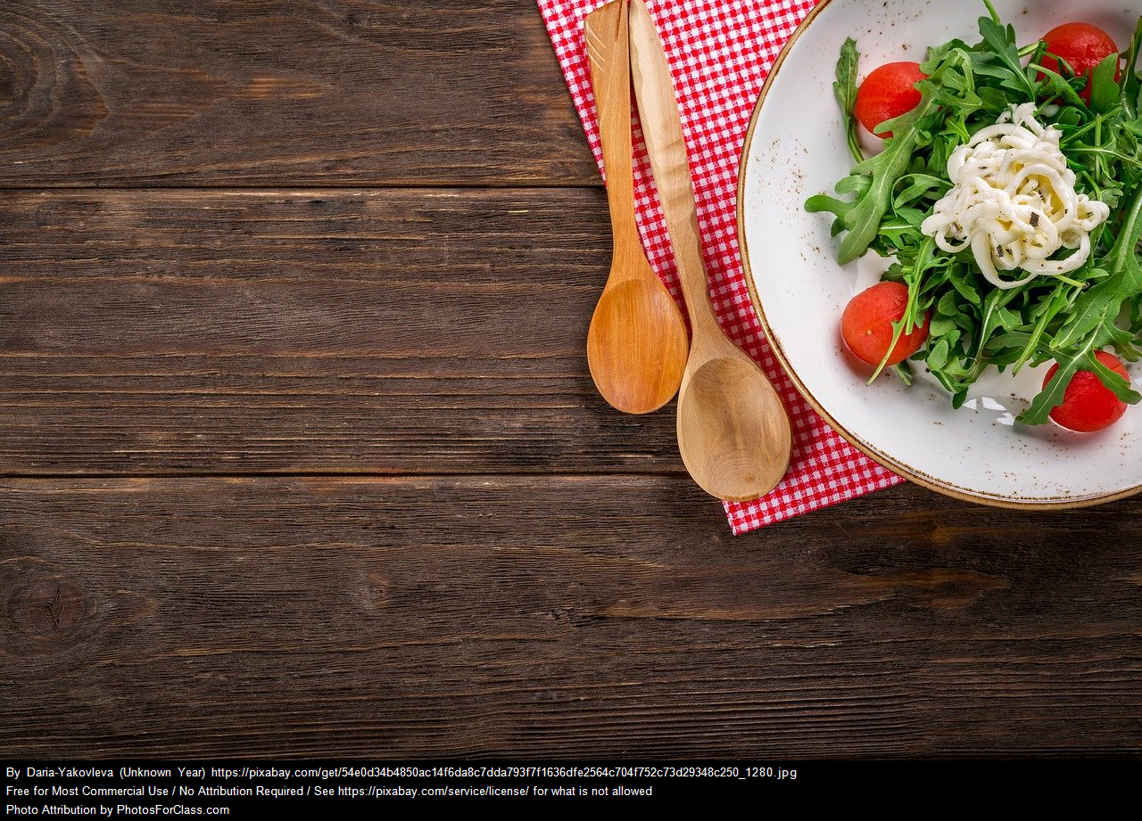
Reverse CookBook
Group memebers:-
1) Prasad Lahamage
2) Prem Methe
3) Hemant patil
4) JaY Misal

Slide 2
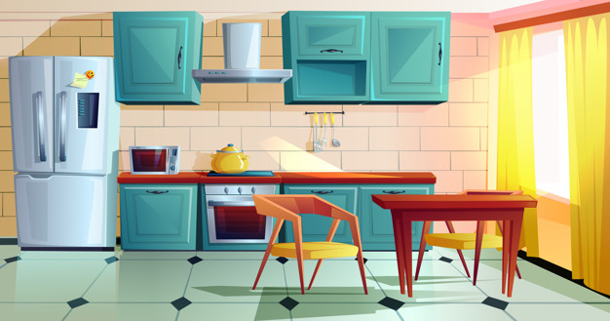



SO WHY REVERSE COOKBOOK?
Dinner
Lunch
Or You Just do not have any idea about how to cook

Slide 3
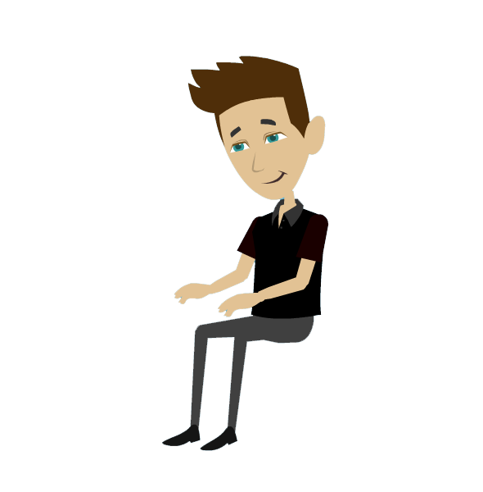


Recipe
Recipe
Recipe

Slide 4
How To Make Pizza?
How To Make Rasmalai?

Slide 5
Ingredients for making to complete your recipe
YOU DON’T HAVE THE MAIN INGREDIENT….

Slide 6
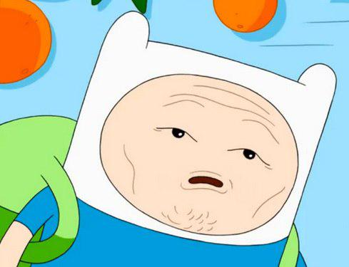

Slide 7
But Don’t Worry
REVERSE COOKBOOK

Slide 8
